Slide 1

Heredity and Evolution
Mendel’s symbols

Slide 2

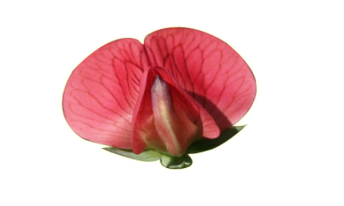
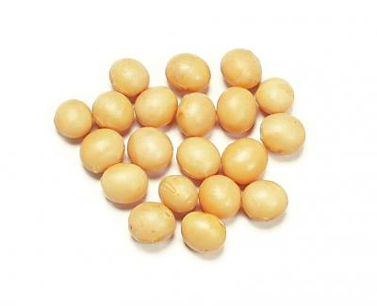
MENDEL THOUGHT
What is responsible for these traits or characters?
MENDEL STATED
Some factors
Which were always present in pairs
Red flower (RR)
Yellow seed (YY)
But, today we know these factors are nothing but
GENES.

Slide 3
MENDEL’S SYMBOLS
Mendel showed Dominant genes with CAPITAL LETTERS
But, Genes are present always in pairs
and Recessive genes with SMALL LETTERS
For eg
Dominant
Recessive
Height of plant
Tall
Dwarf
TT
tt
Colour of flower
Red
White
RR
rr
Pod colour
Green
Yellow
GG
gg

Slide 4

MENDEL used two terms to explain his observations
Appearance of any detectable characteristics of an individual
Phenotype
Genetic composition of an individual
Genotype
Appearance/ Phenotype
RED
Genetic composition / Genotype
RR

Slide 5
Thank You

